Slide 1

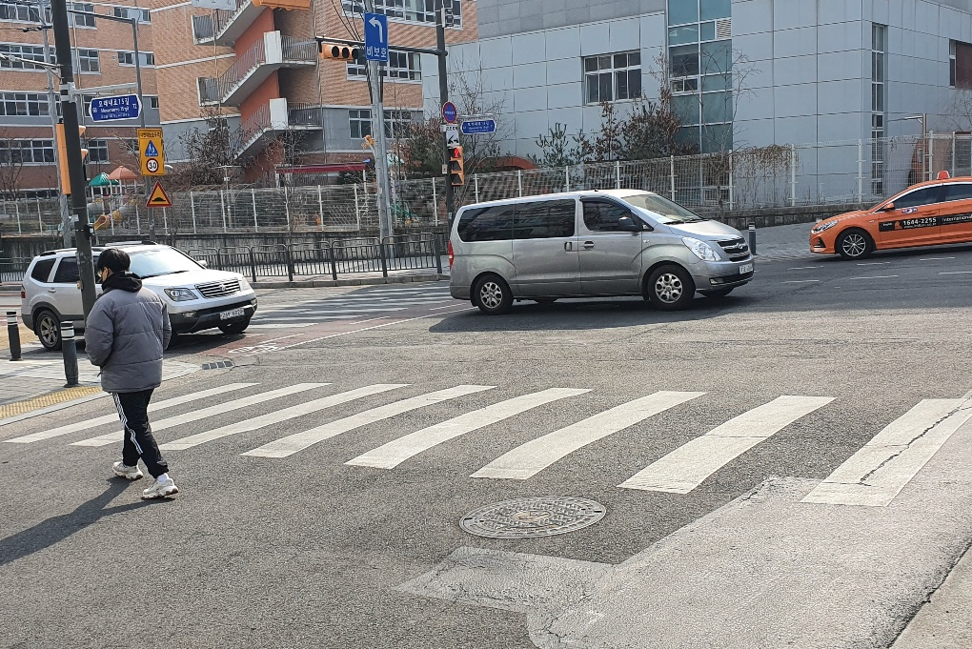


Mask R-CNN
CNN
Predict
state of the object
User
Direct designation
Stage 1 : 데이터 만들기
Stage 2 : 테스트

Slide 2

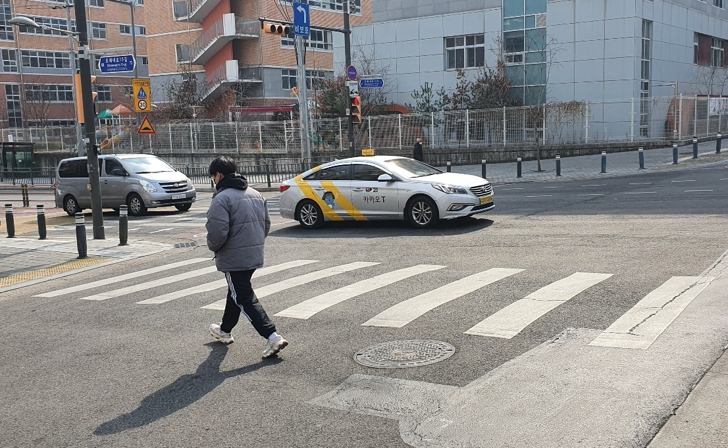


Learning Data :
Test Data :
Mask R-CNN
CNN Model
for Prediction
Object Mask Image
Normal Image
User
Direct designation
Composite Image
Predict
state of the object
Crosswalk Area Image
Stage 1 : 데이터 만들기
Stage 2 : 학습
Stage 3 : 테스트

Slide 3
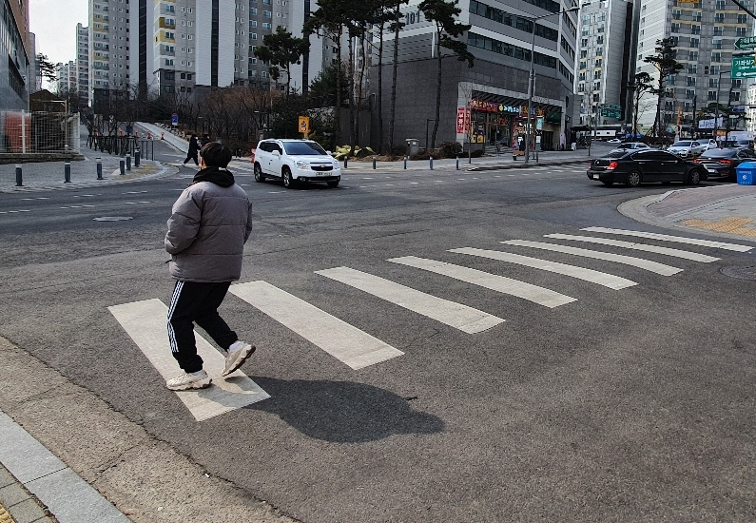
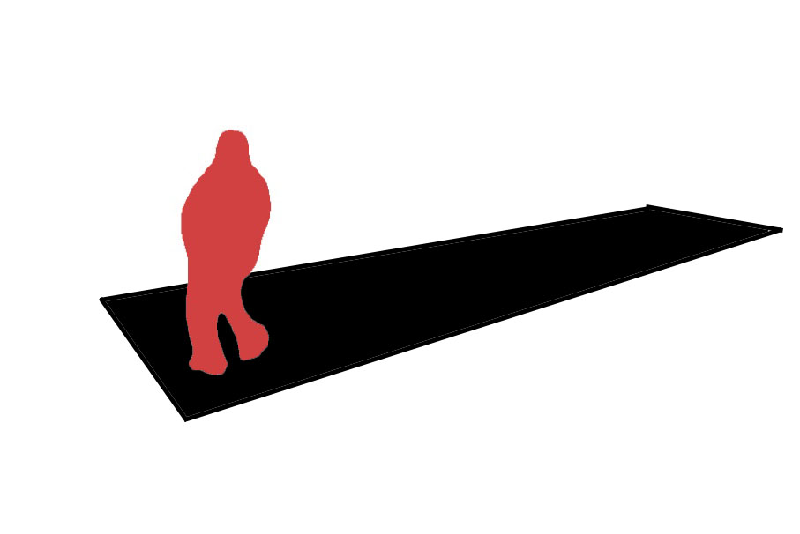
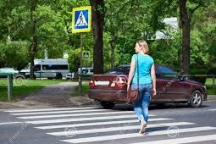
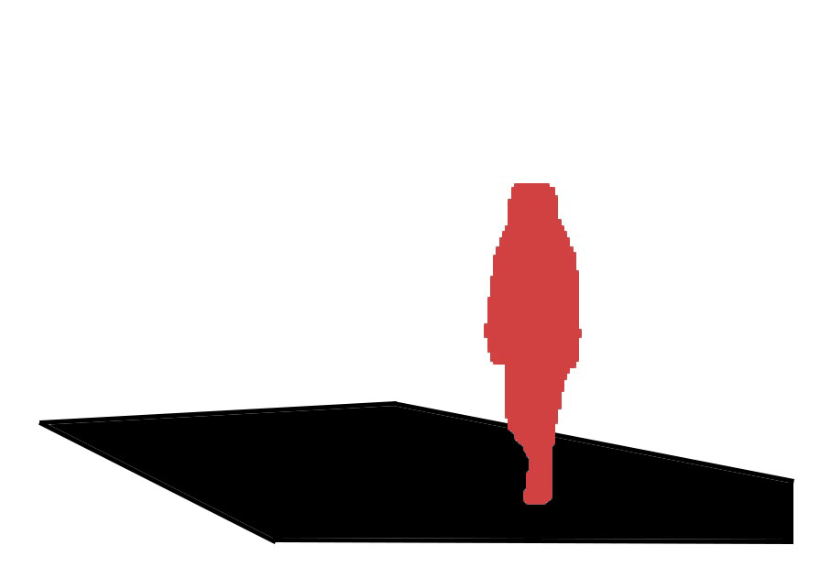
Learning Data :
Test Data :
1
2
3
Training
CNN Model
Mask R-CNN
4
Mask R-CNN
Test
Dangerous
OR
Safe
After Proposed Method Image
Before Proposed Method Image
Data stage
Learning & Test stage

